Slide 1
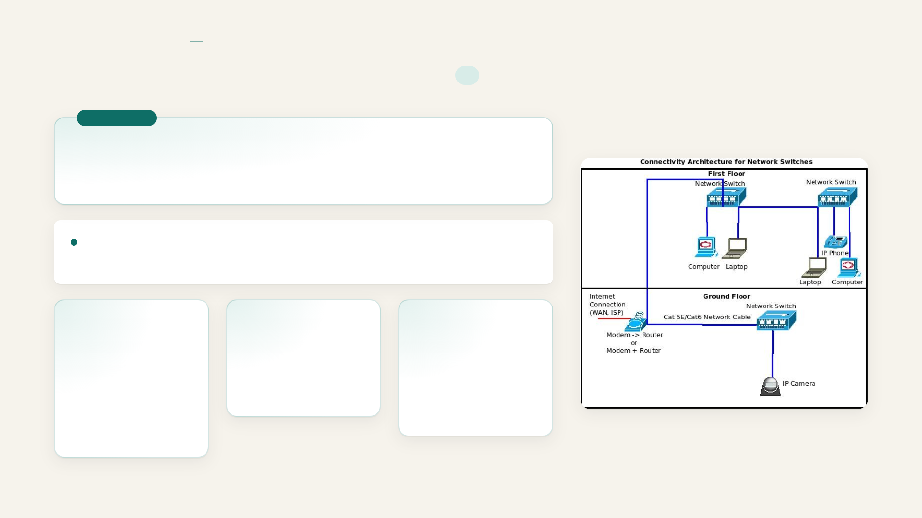
COMPUTER NETWORKS
BASICS
Basics of computer networks
I
DEFINITION
a collection of interconnected devices that communicate to exchange data and resources
Resources enable efficient communication and support services such as email, file sharing, and internet access
Nodes
Routers and switches
Transmission media
Physical devices such as computers, mobiles, or printers
Control the flow of information
Carries data from one device to another
Notes:
Basics of computer networks

Slide 2

COMPUTER NETWORKS
BASICS
Basics of computer networks
II
Wired media
Includes Ethernet and optical fiber cables
Notes:
Basics of computer networks

Slide 3

COMPUTER NETWORKS
WORKING
Working
I
Enables devices to communicate
Allows data exchange
Uses a shared communication system
Follows predefined rules to ensure accurate, efficient, secure data transmission
A network consists of nodes such as computers, servers, routers, and switches that send or receive data
Nodes are connected by links, which may be wired (cable, optical fiber) or wireless (Wi‑Fi radio signals)
Data is broken into small packets before transmission
Notes:
Working

Slide 4

COMPUTER NETWORKS
WORKING
Working
II
Protocols
Firewalls
Define how data packets are formatted, transmitted, received and acknowledged
monitor traffic and allow or block data based on security rules
Each device has a unique IP address
Switches and routers forward packets along the best path
Notes:
Working

Slide 5

COMPUTER NETWORKS
TYPES OF COMPUTER NETWORK ARCHITECTURE
Types of computer network architecture
Computer Network falls under these broad categories.
Client-server architecture
Peer-to-peer architecture
A network type where nodes act as servers or clients, and the server controls client behavior
A network type that operates without a central server, allowing each device to act as a client or a server
Notes:
Types of computer network architecture

Slide 6

COMPUTER NETWORKS
NETWORK DEVICES
Network devices
I
Physical devices that connect computers, printers, and other equipment to a network
Enable data sharing, transfer, and management
Router
Dijkstra
A networking device that connects multiple networks and directs data between them; connects local networks to the internet
Algorithm that finds the shortest path for data packets
Routers use an IP address to forward data directly
Notes:
Network devices

Slide 7
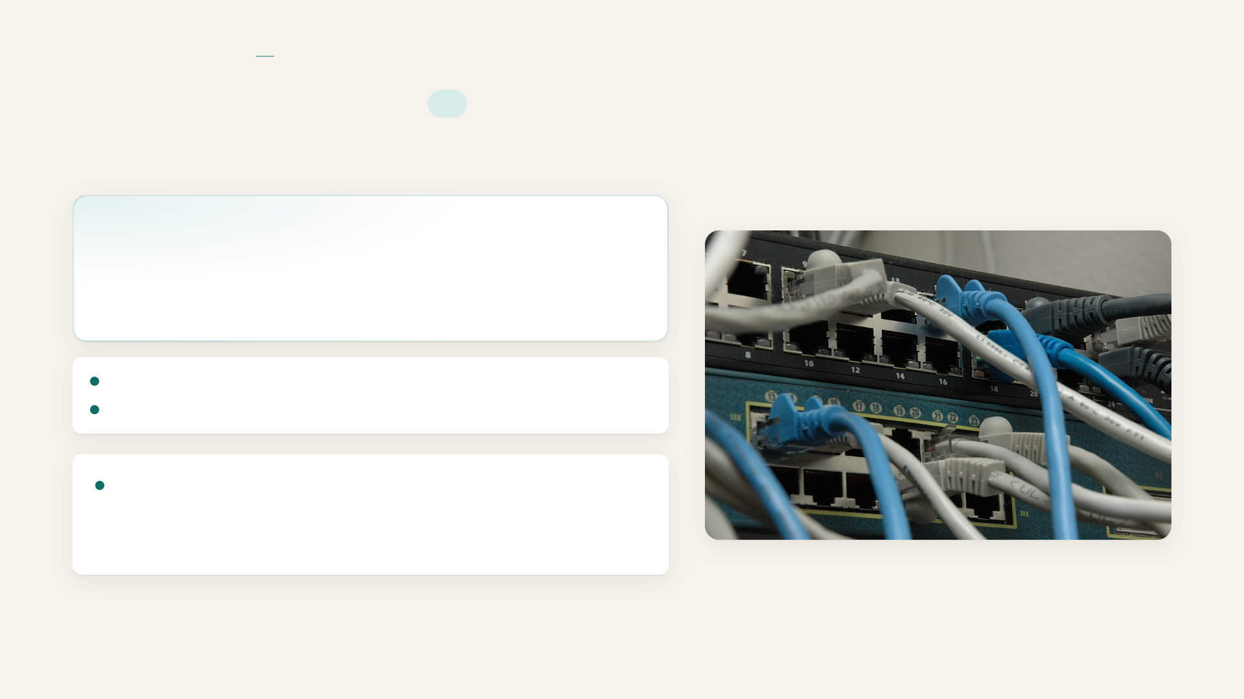
COMPUTER NETWORKS
NETWORK DEVICES
Network devices
II
Switch
A networking device that connects multiple devices within a network
Connects devices within same network
Manages internal network data connection
Connects computers, printers and servers, sending data only to the intended device, improving network efficiency and performance.
Notes:
Network devices

Slide 8

COMPUTER NETWORKS
NETWORK DEVICES
Network devices
III
Hub
Bridge
Gateway
A basic device that connects multiple devices into a network, broadcasting data to all connected devices without filtering; less…
corrects two network segments and filters traffic between them
Connects two different methods that use different protocols, translates data between systems, enables communication, and commonly…
Reduces unnecessary data transmission
Improves network performance
Bridge connects similar networks
Access Point
EPIC
Proverge wireless continuity
Switch works using MAC addresses
Notes:
Network devices

Slide 9

COMPUTER NETWORKS
NETWORK DEVICES
Network devices
IV
Access Point
Modem
Firewall
Extends a wired network into Wi‑Fi, allowing mobile devices to connect wirelessly and improving network coverage area
Converts digital signal to analog and back, connecting a home or office network to the ISP
A security device that monitors and controls incoming and outgoing network traffic based on predetermined security rules.
Blocks unauthorized access
Filters incoming and outgoing data
Protects network from cyber threats
Resource sharing allows multiple users to share hardware
Notes:
Network devices

Slide 10
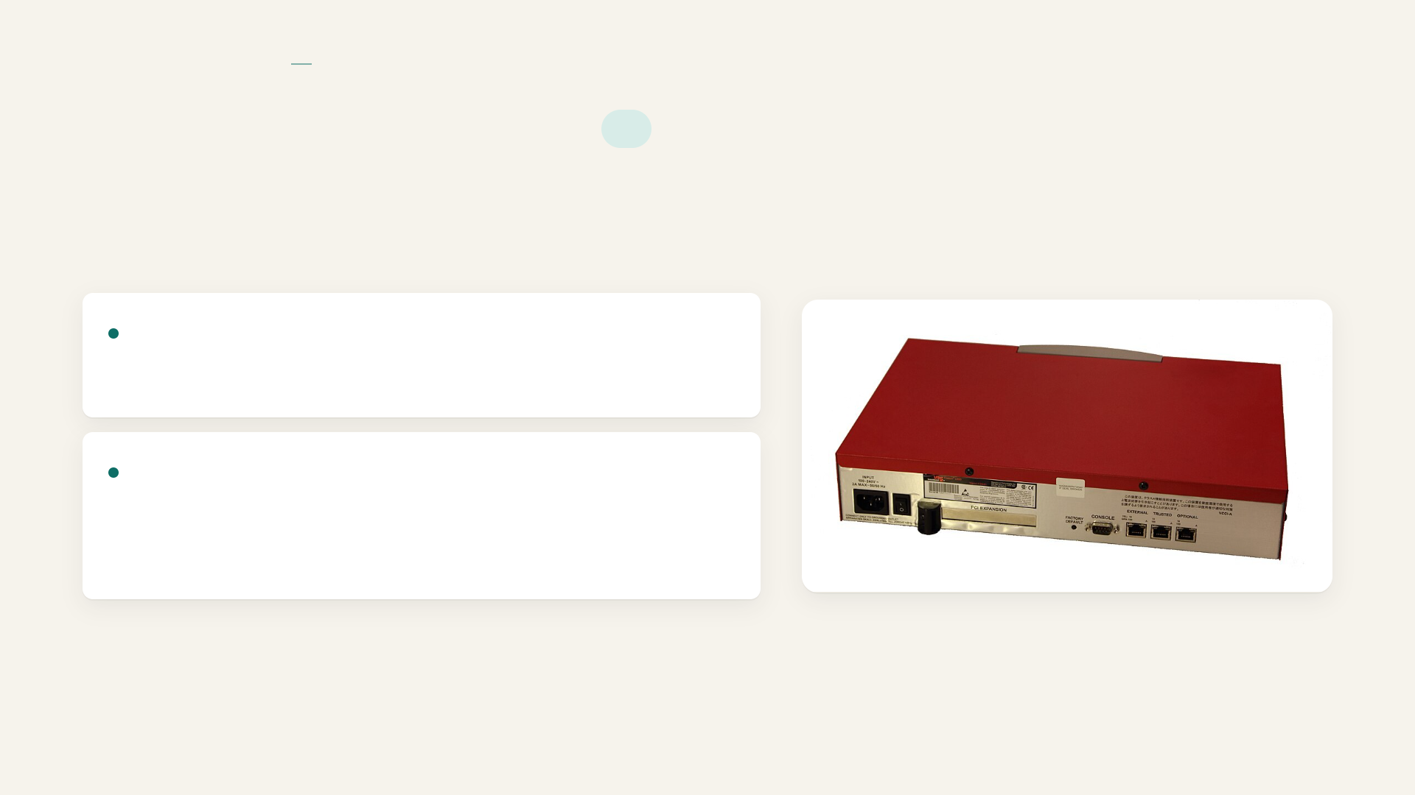
COMPUTER NETWORKS
NETWORK DEVICES
Network devices
V
Enables efficient use of software and data resources
Provides Internet and cloud access for online services and cloud‑based applications
Notes:
Network devices

Slide 11
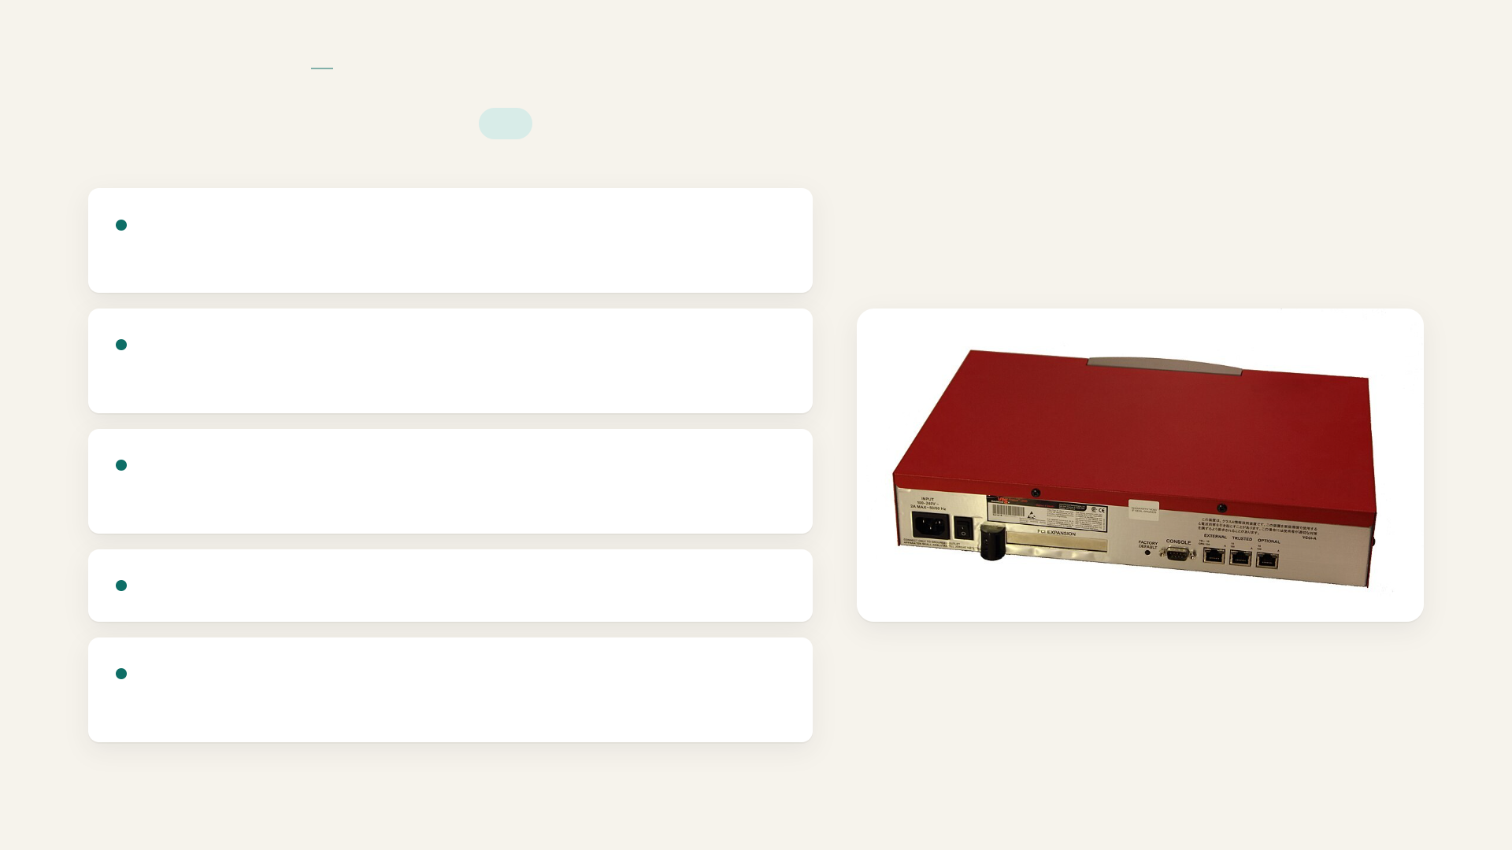
COMPUTER NETWORKS
NETWORK DEVICES
Network devices
VI
Cost efficiency: reduce operational and infrastructure costs via shared resources
Reliability and availability: improve system reliability with backup paths and fault‑tolerant mechanisms
Scalability: support easy expansion by adding devices as demand grows
Growth: add new services as demand increases
Security and control: protects data and network resources using authentication, access control and monitoring
Notes:
Network devices

